Slide 1
Project Management
Introduction to Project Management
Aims of the subject:
The aim of the course is to provide students with an understanding of the theory and practice of project appraisal, planning and control in general.

Slide 2
Project Management
Reading List:
Burke, R.: Project Management Techniques. Burke Publishing; 2nd edition, 2013.
Burke, R.: Introduction to Project Management – managing small projects and events. Burke Publishing, 2008.

Slide 3
Project Management
Reading List:
Barker, S., Cole, R.: Brilliant Project Management: what the best project managers know, do and say. Pearson Business, 2009.
Berkun, S.: The Art Of Project Management. O'Reilly & Associates, 2005.
Burke, R.: Fundamentals of Project Management> Tools and Techniques. Burke Publishing; 2010.
Colleen Garton C., McCulloch, E.: Fundamentals of Technology Project Management. Mc Press; Bk&CD-Rom edition, 2005.
Lock, D.: Project Management. Gower Publishing Ltd; 9th edition, 2007.
Schwalbe, K.: Information Technology Project Management. Fourth Edition, Course Technology, 2005.

Slide 4
Project Management
Assessment strategy and method:
Course work (25 %)
Written examination (75 %)
December/January?

Slide 5
Project Management
History of Project Management
referred back as far as the construction of the Egyptian Pyramids and Great Wall of China
there was definitely a clear need for some kind of project management skills since the beginning of mankind history
the history of project planning techniques can be accurately traced back to the end of 19th and the beginning of 20th century when Henry Gantt (1861-1919) designed the barchart as a visual aid for planning and controlling his projects
motivated by contemporary approaches to management in general (Frederick Winslow Taylor, Henry Gantt) – every task should be divided into sequence of elementary activities (movements), useless activities must be eliminated, the remaining activities must be accomplished efficiently (ergonomics, stress on every individual’s top performance, foundations of modern manufacturing lines)

Slide 6
Project Management
Example:
Gantt chart - How to publish a brochure in twelve days?

Slide 7
Project Management
Example:
Gantt chart can be easily used as a tool for project control

Slide 8
Project Management
„Modern“ History of Project Management
Remington Rand Univac developed Critical Path Method (CPM) - a management tool to improve the planning and control of a construction project (processing plant for Du Pont Corporation) - it was first used in 1957
US Navy together with Lockheed Aircraft Corporation developed Program Evaluation and Review Technique (PERT) - it was used as a planning tool for the Polaris Submarine project (in 1958)
both methods are based on project presentation in the form of network diagram, the difference is mainly in the way how activity time durations are addressed (PERT - probabilistic approach, CPM - deterministic approach)
NASA experiments with matrix organisation structures (1960)

Slide 9
Project Management
„Modern“ History of Project Management
The mid 1960s saw a dramatic rise in the number of projects in the construction industry
Project Management Institute was formed in 1969 - its goal is to bring forward the best practices and to create standard terminology and guidelines for project management. The Fourth Edition (2008) was recognized by the American National Standards Institute (ANSI) as an American National Standard (ANSI/PMI 99-001-2008) and by the Institute of Electrical and Electronics Engineers — IEEE 1490-2011 (so called PMBOK Guide – A Guide to the Project Management Body of Knowledge)
There is a whole variety of software packages available for personal computers today - it makes our life easier, but still we have to understand the basic foundations and principles of PM to be able to make right decisions

Slide 10
Project
Project Definition
Project can be defined as a group of activities that have to be performed in a logical sequence to meet preset objectives.

Slide 11
Project Examples
Construction project - designing and constructing a house, bridge, supermarket
Product development project - designing and testing a new car or refrigerator
Maintenance project – repairing or maintaining equipment
IT project – designing and implementing a new information system
Advertising and marketing project – launching and promoting some product or service
Office project – moving office or establishing a new one
Human resource project – designing and implementing a new organizational structure

Slide 12
Project Examples
Training and education project – developing a program or a new course
Social project –new services for mothers, retired, handicapped or unemployed people
Travel project – planning a study/business trip or holiday/vacations
Sport project – football tournament, Olympic Games
Entertainment or cultural project – fashion show, exhibition, Madonna’s world tour
Domestic project – planning a family weekend, wedding or birthday party

Slide 13
Types of Projects
Project could be classified by focusing on their type, scope, cost, importance, etc.
Interesting way of classifying projects is by focusing on the clarity of objectives and the development of the project management processes and tools:
Fog type – project participants and stakeholders are not sure what is to be achieved and how it is to be carried out (pure research – mathematics, theoretical physics)
Movie type – project participants and stakeholders have a high degree of a certainty of how the project is to be carried out, but not what is to be delivered (new film, exhibition, game)
Quest type – project participants and stakeholders have a high degree of a certainty of what should be done, but they are not sure of how to achieve it (new medicament, new generation car, national security)
Painting by numbers – project participants and stakeholders have a high degree of a certainty about what is to be done and how to achieve it (house construction, face lifted car, package holiday)

Slide 14
Features of a project
A project has a clear start and finish.
There are several distinct phases between the beginning and the end of a project – we call it lifecycle of the project.
Projects are often time-limited. It means that they must finish by a certain date.
Project usually has a clear budget that is often broken down to a budget per work package.
There is a single point of responsibility – project manager (project leader) is responsible for the whole project.
There is usually a project team – team formed to complete the project.

Slide 15
Project Management
Project Management is the application of knowledge, skills, tools and techniques to project activities in order to meet stakeholders’ needs and expectations from a project (definition by the PMBOK).
Project Management
= MAKING THE PROJECT HAPPEN

Slide 16
Project Management
Any project requires that we
know WHAT is to be delivered/produced (output)
can recognise if it HAS been produced (measures)
know WHEN it must be completed (time)
know WHAT resources are needed (money, personnel, machinery)

Slide 17
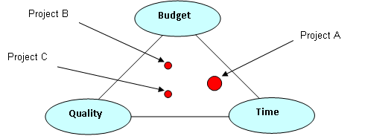
Project Objectives
Quality (fitness for purpose)
Budget (to complete it within the budget)
Timescale (to complete it within the given time)
It is clear that these objectives are not in harmony!

Slide 18
Project Lifecycle
Every project passes through a number of distinct phases or stages – from project conception, through project execution to project completion and termination. These phases are known as the “Project Life Cycle”.
The project life cycle is conveniently represented by a barchart which clearly indicates the duration of each phase and its overlap (if any) with the other phases.

Slide 19
Project Lifecycle
Example:
the construction of a house
Feasibility study – is conducted to consider all the options and alternatives. The output of this phase is an outline of the preferred type of house and estimated budget.
Project Phase | 1 | 2 |  | 3 |  |  |  |  |  |  |  | 4
Feasibility study
House design
Building phase
Commissioning phase

Slide 20
Project Lifecycle
Example:
the construction of a house
House design – on acceptance of the feasibility study a detailed design of the house is produced together with detailed scope of work and planning documents (ranging from planning schedules, procurement, resources and budget up to the building permission).
Project Phase | 1 | 2 |  | 3 |  |  |  |  |  |  |  | 4
Feasibility study
House design
Building phase
Commissioning phase

Slide 21
Project Lifecycle
Example:
the construction of a house
Building phase – on acceptance of the design of the house detailed baseline plan, the contracts are negotiated and settled. The house is built to the detailed plans developed in the previous phase.
Project Phase | 1 | 2 |  | 3 |  |  |  |  |  |  |  | 4
Feasibility study
House design
Building phase
Commissioning phase

Slide 22
Project Lifecycle
Example:
the construction of a house
Commissioning phase – on completion the building is inspected and approved by the client and responsible authorities. The house is handed over for occupation and the project is terminated.
Project Phase | 1 | 2 |  | 3 |  |  |  |  |  |  |  | 4
Feasibility study
House design
Building phase
Commissioning phase

Slide 23
Project Lifecycle
Example:
computer system installation
We can see that even within project lifecycle there could be some overlapping activities there.
Project Phase | 1 |  |  | 2 |  | 3
Feasibility study
System selection
Staff training
Implementation

Slide 24
Project Lifecycle
Different phases of the project are associated with different level of effort. The greatest level of effort usually occurs during the implementation phase (as well as most of the costs are incurred) and that is why many tools and techniques are focused right on this phase.
Level of Effort
Project Phase | 1 | 2 |  | 3 |  |  |  |  |  |  |  | 4
Feasibility study
House design
Building phase
Commissioning phase

Slide 25
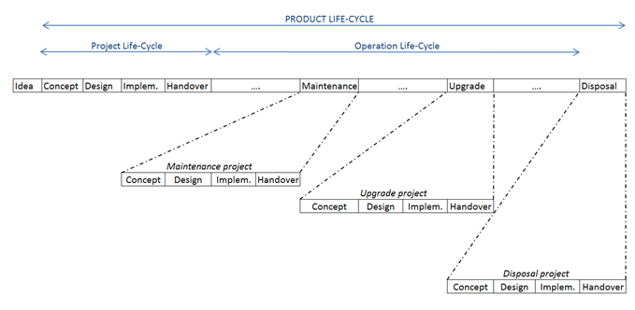
Product Lifecycle
The project lifecycle only considers the project from concept to handover while the product lifecycle considers the product from conception to disposal.
It is quite often extremely important to plan the whole product lifecycle. For example, it is not enough to build a nuclear power station as we have to safely manage it over the whole period of its operation and that is has to be dismantled according to very high security standards.

Slide 26
Product Lifecycle
Maintenance Phase
Almost all products have to be maintained in order to keep it operational and running efficiently. Ease of maintenance, minimum impact on production/utilization and time out of operation are very important considerations.
Upgrade, Regular Refit or Expansion Phase
At some point the facility requires a major refit, upgrade, or expansion to keep it running efficiently. The necessity of upgrade could be influenced by the used technology itself, new technology available, competition, regulations etc. Ease of upgrade or expansion should be considered and allowed for in the original design.

Slide 27
Product Lifecycle
Decommission and Disposal
This is the final part of the product lifecycle and there are many ways how to do it depending on the product itself. Disposal may mean a trip to a scrap yard up to a very complex and elaborated procedure when technologically complex and even dangerous facility has to be dismantled without any negative impact on the environment.
Assignment
Think about two major projects that were carried out in your city or country. One of them should be a successful project, while the other should be an example of a failure. Could you find some reasons why the second project failed?

